Slide 1
Data, Data, and More Data…
CS 5540
(Rao)

Slide 2
Types of Data
Unstructured
Semistructured
Structured

Slide 3
Unstructured Data
Textual content – mainly for human understanding/cognition
HTML web pages
PDF files, MS Word files
Emails
Posts on social media sites such as Facebook and Twitter
Blogs
Text messages

Slide 4
Structured Data
There is a defined structure on how the data should be stored and represented
Relational databases store data in tables
SSN | Name | Age | Salary | Phone
1234 | John Doe | 25 | 100000 | 123-45678
2345 | Jim Doe | 35 | … | …
… | … | … | … | …
Employee
Course | Department | SSN
CS490JU | CSEE | 5678
… | … | …
… | … | …
… | … | …
Tables
Courses

Slide 5
Example
List the SSN and salary of each employee who teaches a course along with the course number and sort the results by salary -- low to high
SELECT E.SSN, E.Salary, C.Course
FROM Employee as E, Courses as C
WHERE E.SSN = C.SSN
ORDER BY E.Salary
Notes:
Table alias

Slide 6
Semistructured Data
No need of a fixed structure/schema
Data can have partial/loose structure
Example
XML data model
RDF data model; also referred to as “schema-free”
JSON

Slide 7
What is Big Data?
Velocity
Volume
Variety
Big Data!
Other V’s: Veracity, Value, …
Notes:
Veracity

Slide 8
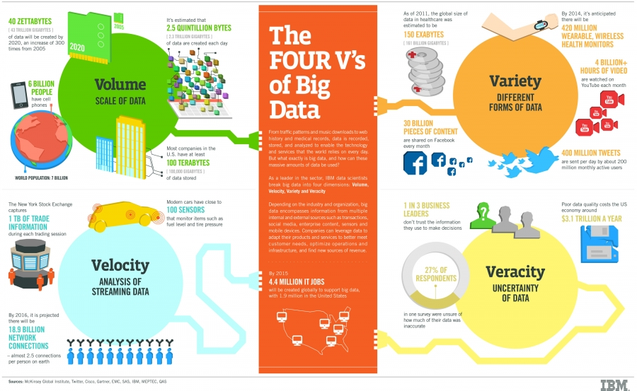
Nice Illustration

Slide 9
Key Points
Volume
Very large amounts of data
Petabytes (10¹⁵ bytes) and more
Variety
Structured + unstructured + semistructured data
Velocity
High rate of arrival of data
Stock quotes, Twitter tweets, sensor readings, web clicks, and many more

Slide 10
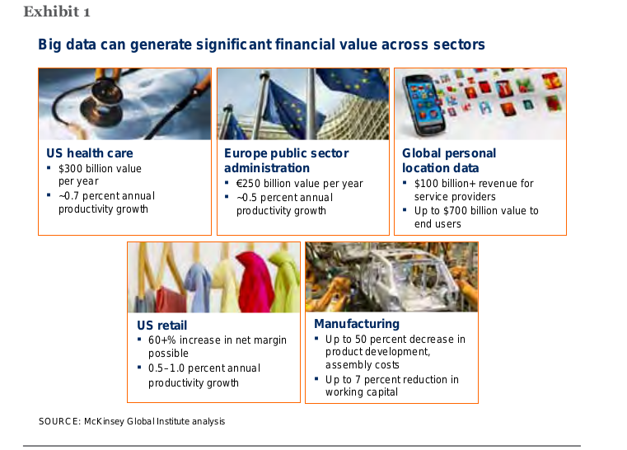
Impact?

Slide 11
A Tweet
dbs@DBS:~$ cat ~/Tweets/json/test.json
{"contributors":null,
"text":"ポカーン。",
"geo":null,
"retweeted":false,
"in_reply_to_screen_name":null,
"truncated":false,
"lang":"ja",
"entities":{"urls":[],"hashtags":[],"user_mentions":[]},
"in_reply_to_status_id_str":null,
"id":289429398778687488,
"source":"<a href=\"http://twitter.com/download/iphone\" rel=\"nofollow\">Twitter for iPhone<\/a>",
"in_reply_to_user_id_str":null,
"favorited":false,
"in_reply_to_status_id":null,
"retweet_count":0,
"created_at":"Thu Jan 10 17:52:00 +0000 2013",
"in_reply_to_user_id":null,
"id_str":"289429398778687488",
"place":null,
"user":{
"location":"",
"default_profile":true,
"statuses_count":1885,
"profile_background_tile":false,
"lang":"ja",
"profile_link_color":"0084B4",
"profile_banner_url":"https://si0.twimg.com/profile_banners/459434688/1357637886",
"id":459434688,
JSON: name/value pairs, arrays

Slide 12
"following":null,
"favourites_count":0,
"protected":false,
"profile_text_color":"333333",
"description":"そば屋にいるね",
"verified":false,
"contributors_enabled":false,
"profile_sidebar_border_color":"C0DEED",
"name":"まさひろ。",
"profile_background_color":"C0DEED",
"created_at":"Mon Jan 09 17:22:25 +0000 2012",
"default_profile_image":false,
"followers_count":113,
"profile_image_url_https":"https://si0.twimg.com/profile_images/2093645100/image_normal.jpg",
"geo_enabled":false,
"profile_background_image_url":"http://a0.twimg.com/images/themes/theme1/bg.png",
"profile_background_image_url_https":"https://si0.twimg.com/images/themes/theme1/bg.png",
"follow_request_sent":null,
"url":null,"utc_offset":null,z
"time_zone":null,
"notifications":null,
"profile_use_background_image":true,
"friends_count":104,
"profile_sidebar_fill_color":"DDEEF6",
"screen_name":"HiSoftbank",
"id_str":"459434688",
"profile_image_url":"http://a0.twimg.com/profile_images/2093645100/image_normal.jpg",
"listed_count":0,
"is_translator":false},
"coordinates":null
}
Notes:
Friends_count – two way

Slide 13
Apache Hadoop
Open-source framework for storing and processing large amounts of data on a cluster of machines
http://hadoop.apache.org
MapReduce Framework
Write parallel programs, execute the programs on a cluster of machines
Hadoop Distributed File System (HDFS)
A distributed file system to store large number of large files using a cluster of machines

Slide 14
File System Basics
A file has two main parts
Metadata
Name of the file, creation time, size, permissions, pointers to data blocks
Data blocks
Actual content of the file is broken down into equal-sized blocks
Notes:
See board

Slide 15

HDFS
Source: http://hadoop.apache.org/docs/stable/images/hdfsarchitecture.gif

Slide 16
MapReduce Model
Intermediate
data
output
data
map
reduce
data
map
reduce
data
map
reduce
data
map

Slide 17
IBM BigInsights
http://bigdatauniversity.com/
Need to create an IBM universal id
Free download
VMWare image is available
SUSE Linux
Notes:
Start with simple Linux instances, do some file operations

Slide 18
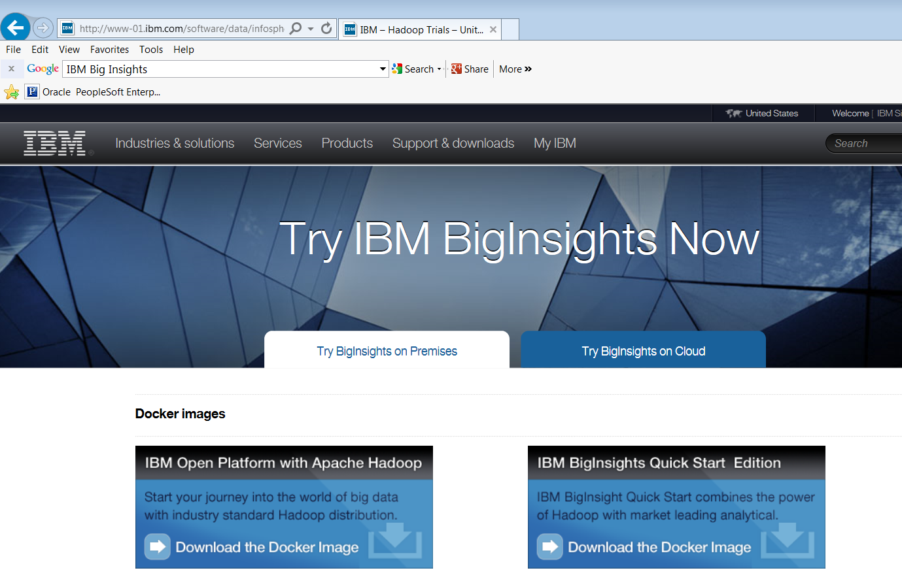
Getting Started
http://www-01.ibm.com/software/data/infosphere/hadoop/trials.html

Slide 19
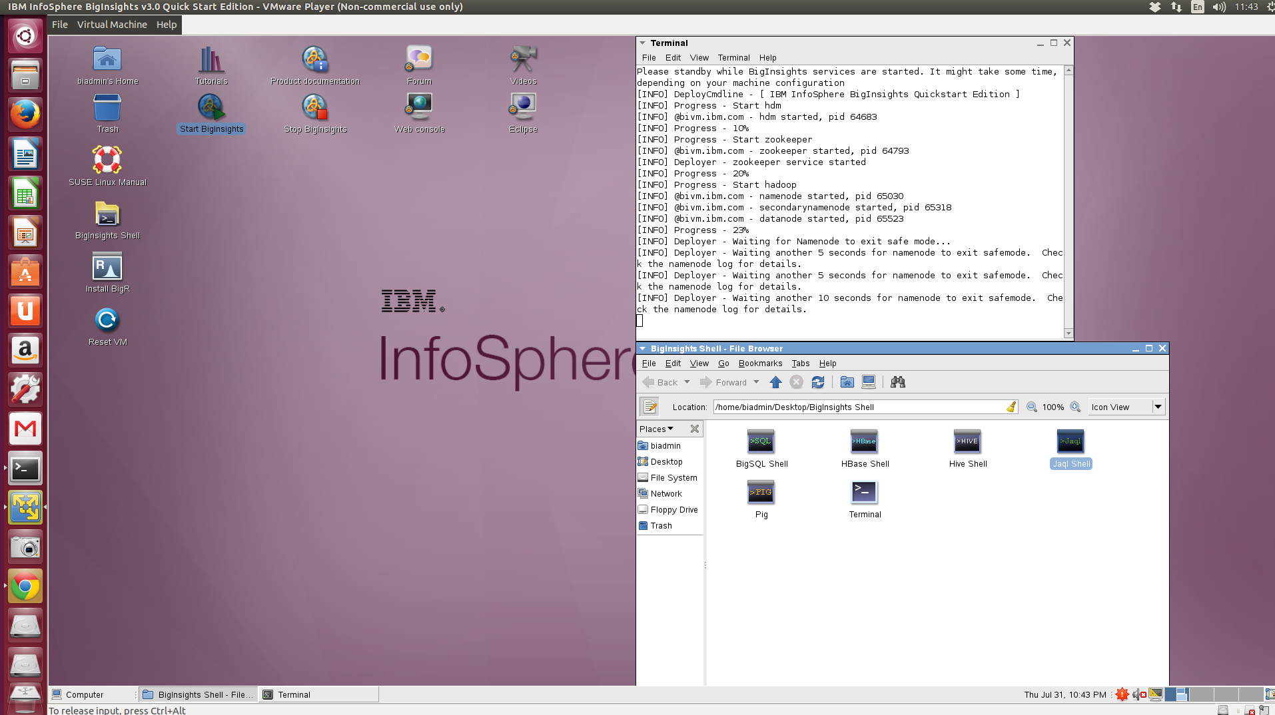
Ready, Set, Go!
click any of these

